Slide 1
Enterprise Application Architecture (EAI)
SE495: Software and Systems Integration

Slide 2
Outline
Introduction
Architectures
Middleware
What is EAI
A Typical EAI System
EAI Benefits
Workflow Management Systems

Slide 3
Introduction

Slide 4
Enterprise Application Integration (EAI)
Enterprise Application Integration (EAI) shares data and business processes between an organization’s different applications.
Enterprise application integration functions as the glue for a company. These systems unite multiple applications and workflows into one structure.
They allow a company to use information consistently, keeping everyone on the same page automatically.
It’s more than just connecting two applications to share data – it’s about integrating business processes and systems to work together harmoniously.
This is most needed where inventory control, human resources, sales automation, and database management are designed to run separately, without interaction.

Slide 5
Enterprise Application Integration (EAI)
Provides the means to share data between different applications without writing custom interfaces.
Example:
Consider a company that wants to do build an eCommerce portal.
Has a number of legacy applications (or even an ERP solution in place)
Need build the web-based eCommerce infrastructure and link with systems that do functions like process orders, manage inventory, ship products
The company decides to use a major courier service for delivery of products ordered from the web site.
The company wants an ODS for analysis of transactions taking place on the site

Slide 6
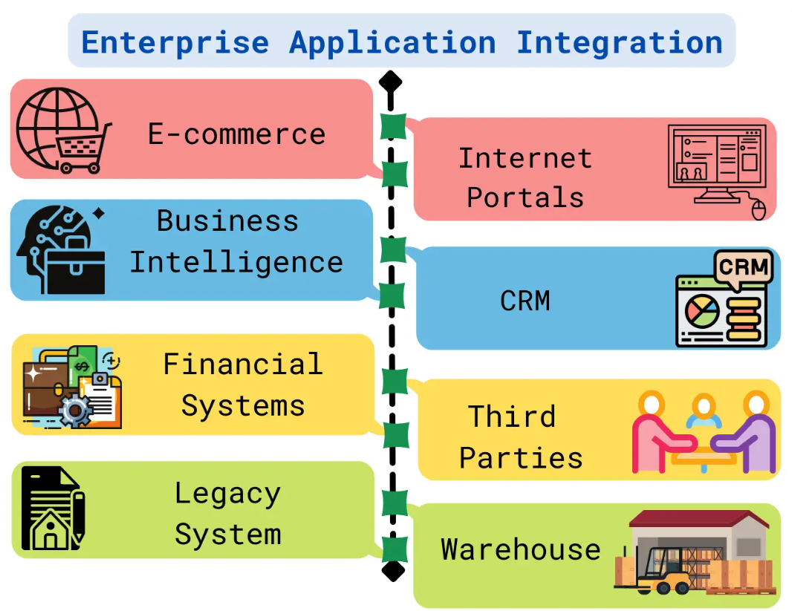
Enterprise Application Integration (EAI)

Slide 7
Example
eCom
Site
Order
System
Inventory
ODS
Shipping
Courier
One solution – custom Interfaces Issues?

Slide 8
Example
eCom
Site
Order
System
EAI
ODS
Inventory
Shipping
Courier
Alternative – employ EAI solution

Slide 9
Advantages of EAI
Cost effectiveness
Time to market
Scalability
Ability to deal with complex environments
Real-time access to information
Streamlined business processes
Efficient access to information
Timely information and data transfer across the system

Slide 10
EAI Components
Business Rule Component: to allow the applications to understand your business processes.
Business Logic Modules (i.e. supply planning, sales order processing. Methods for business process management.)
Transformation tools (to define how to map data from one system to another)

Slide 11
EAI Components …. Cont…
Data Acquisition Component: to allow access to the Data Source and Target Interfaces (i.e. Siebel, SAP, PeopleSoft, ODBC, Oracle, CICS, IMS) - note that the data acquisition component is crucial to EAI success. Most vendors refer to these interfaces as "adapters“
Adapters understand the data structures associated with applications and the means by which to access the data. (SAP/ABAP). map heterogenous data formats, interfaces and protocols into a common model and format. Hide heterogeneity and present uniform view of layers below.
Notes:
An adapter is a software t
ABAP stands for Advanced Business Application Programming. It is a programming language developed by SAP. SAP is a German company that develops ERP (Enterprise Resource Planning System) systemshat an application server or an application client uses to connect to a specific Enterprise Information System (EIS).
Heterogeneous computing refers to systems that use more than one kind of processor or cores. These systems gain performance or energy efficiency not just by adding the same type of processors, but by adding dissimilar coprocessors, usually incorporating specialized processing capabilities to handle particular tasks.

Slide 12
EAI Components …… Cont….
System Development Component: to allow programmers to design and test custom requirements - Design tools (for business process design, debugging, and testing)
Notes:
Business process design (BPD) is the act of creating a new process or workflow from scratch. It's different from business process redesign, which as the name implies, means t
business process modeling in business process management and systems engineering is the activity of representing processes of an enterprise, so that the current process may be analyzed, improved, and automated.aking an already existing process and improving it. But before we dive into that, talk processes.

Slide 13
EAI - Components
System Control Component: Should have the following features:
Management tools (for application-specific monitoring)
Directory tools (for locating other applications on different platforms), particularly support for the Lightweight Directory Access Protocol (LDAP)
Commitment control management mechanisms (for control of business-level logical units of work)
Strong support for metadata management
Notes:
Lightweight Directory Access Protocol (LDAP) is a client/server protocol used to access and manage directory information. It reads and edits directories over IP networks and runs directly over TCP/IP using simple string formats for data transfer
Metadata management is the administration of data that describes other data. It involves establishing policies and processes that ensure information can be integrated, accessed, shared, linked, analyzed and maintained to best effect across the organization.

Slide 14
EAI - Components
Message Brokers (to control transactions, control security, and perform event notification. The product should also include the capability to "bridge" messages between different messaging systems (facilitates the interaction among adapters)
Scalability for high-volume transaction throughput. It is almost impossible to know at implementation time what the data volumes will be in the future – therefore, EAI must be scalable.
Support for varying levels of fault tolerance, load balancing, and failover for mission-critical systems. Workflow enablement is a key requirement to reduce latency between distributed processes.
Notes:
Failover is a backup operational mode in which the functions of a system component (such as a processor, server, network, or database, for example) are assumed by secondary system components when the primary component becomes unavailable through either failure or scheduled down time.
mission critical system is a system that is essential to the survival of a business or organization. When a mission critical system fails or is interrupted, business operations are significantly impacted. A mission-critical system is also known as mission essential equipment and mission critical application.

Slide 15


Typical EAI system
integrating application
(contains the composition logic)
message broker
SmartQuotation
adapter
database
adapter
SmartForecasting
adapter
e-mail
adapter
XYZ
adapter
SmartQuotation
DBMS
applications
SmartForecasting
XYZ

Slide 16
Message Brokers
Message oriented middleware
Supporting integration of heterogenous systems
Logic for routing messages
Filtering and processing messages

Slide 17
Old message-based interoperability
inventory
management
payment-
system
dispacher
shipping
month-end
closing
new PO
message-oriented middleware
Notes:
Message-oriented middleware is software or hardware infrastructure supporting sending and receiving messages between distributed systems.
The Message Dispatcher EIP consumes messages from a single channel and distributes them among performers. It allows multiple consumers on a single channel to coordinate their message processing.
A purchase order (PO) is a commercial document and first official offer issued by a buyer to a seller indicating types, quantities, and agreed prices for products or services. It is used to control the purchasing of products and services from external suppliers.

Slide 18
Message Brokers
inventory
management
payment-
system
dispacher
shipping
month-end
closing
new PO
message broker
Notes:
A message broker is an architectural pattern for message validation, transformation, and routing. It mediates communication among applications, minimizing the mutual awareness that applications should have of each other in order to be able to exchange messages, effectively implementing decoupling.

Slide 19
Difference
In basic MOM it is the sender who specifies the identity of the receivers.
With message brokers, custom message routing logic can be defined at the messae broker level or at the queue level.
sender
receiver
message broker core
Notes:
Message oriented middleware .

Slide 20
Routing logic
sender‘s identity
message type
message content
Definition
message broker level
queue level
Notes:
A message broker is an architectural pattern for message validation, transformation, and routing. It mediates communication among applications, minimizing the mutual awareness that applications should have of each other in order to be able to exchange messages, effectively implementing decoupling.

Slide 21
What is EA?
Its not technical!
Aligning IT to business.
Answering all of the enterprise needs
Transverse view.
knowing and managing the current situation, paving the road for the wanted one.
Implementation of information management
Enforce homogeneous solutions and enable “One system” to the users.
Notes:
The transverse plane or axial plane (also called the horizontal plane or transaxial plane) is an imaginary plane that divides the body into superior and inferior parts. It is perpendicular to the coronal plane and sagittal plane.

Slide 22
Architectures
1 layer architecture
monolithic Information Systems
presentation, application logic, and resource management were merged into a single tier
2 layer architecture
separation of presentation layer from other 2 layers (app + resource)
became popular as 'server/client' systems
3 layer architecture
can be achieved by separating RM (resource management) from application logic layer
Notes:
In software engineering, a monolithic application describes a single-tiered software application in which the user interface and data access code are combined into a single program from a single platform.
A monolithic application is self-contained, and independent from other computing applications. The design philosophy is that the application is responsible not just for a particular task, but can perform every step needed to complete a particular function.
Application Logic is mostly workflow logic. It is the application specific coordination of domain and infrastructure components according to the requirements of that particular application.

Slide 23
Multi-tier Architectures
Where to put the business-logic?
Client tier -> NO!
Fat clients
Reimplementing it for each different type of client
Redistributing clients after each software update
Data tier -> NO!
Vendor and technology dependence grows
Different applications have different needs for the same data
Performance issues in resource usage
Notes:
Business logic is the custom rules or algorithms that handle the exchange of information between a database and user interface. Business logic is essentially the part of a computer program that contains the information (in the form of business rules) that defines or constrains how a business operates.
A fat client (also called heavy, rich or thick client) is a computer (clients), in client–server architecture or networks, that typically provides rich functionality independent of the central server.

Slide 24
Multi-tier Architectures
Where to put the business-logic?
Middle tier -> YES!
Business logic has its own tier
Client tier
user interfaces
Middle tier business logic
Data tier
data sources
Web browsers
HTML, Java
Web
Server
Middleware
Server
Databases
GUI clients
C++, VB, Java
Legacy Systems
Notes:
Middleware is computer software that provides services to software applications beyond those available from the operating system. It can be described as "software glue".

Slide 25
Middleware I
Allows communication
through a standard language
across different platforms
between legacy and moderm applications
Takes care of
transactions between servers
data conversion
authentication
communications between computers

Slide 26
Middleware II
Provides runtime environment for components in the middle-tier
Component lifecyle and management
Transaction, event and security services
Provides connections to databases, mainframes and legacy systems
Seperates client-tier from the data source
Clean seperation of user-interfaces and presentation logic from the data source

Slide 27
Middleware III
Main use today: Legacy wrapping for thin client architectures
User interfaces
Client-tier (GUI applications, browsers)
Business logic
Middle-tier (CORBA/EJB/COM server)
Data sources
Data-tier (databases, mainframes)
Notes:
A COM server is any object that provides services to clients; these services are in the form of COM interface implementations that can be called by any client that is able to get a pointer to one of the interfaces on the server object. There are two main types of servers, in-process and out-of-process.
Common Object Request Broker Architecture
CORBA is essentially a design specification for an Object Request Broker (ORB), where an ORB provides the mechanism required for distributed objects to communicate with one another, whether locally or on remote devices, written in different languages, or at different locations on a network.
EJB is a server-side software component that encapsulates business logic of an application. An EJB web container provides a runtime environment for web related software components, including computer security, Java servlet lifecycle management, transaction processing, and other web services

Slide 28
Importance of EAI
A step forward in the evolution of middleware
Integrates applications and enterprise data sources so that they can easily share business processes and data.
Integration is done without significant changes of applications and data sources.
Vendor independence: Rules of specific business applications or business policies need not be re-implemented even if one of the business applications is replaced with a different vendor’s application
Data integration: Ensures consistent information in multiple systems
Common facade: Users need not learn different software applications because it provides a compatible software application access interface

Slide 29
Middleware
Middleware
Middleware
EAI
Middleware
Middleware
Middleware

Slide 30
ERP System
Internal Applications
(Java,C,C++)
CRM System
EAI
Enterprise Portal
Application
Databases
Financial System
Legacy System
SCM System

Slide 31
Example: a simple supply chain
Ordering System
purchase
order
Business Process
Management
CRM System
document
customer-contact
Warehouse
Controlsystem
check
availability
not
available
available
ERP System
order atricle
Financial System
write invoice
Manufacturing
System
deliver goods

Slide 32
EAI benefits:
It increases the speed of communication between Enterprise apps.
Lower development costs
Integration is simpler because systems are more loosely coupled than in object brokers
Lower opportunity costs
Integration is done more quickly
corresponding cost savings reachieved sooner
Lower maintenance effort
adapters extract the interaction with external systems
significant advantage from the software engineering point of view

Slide 33
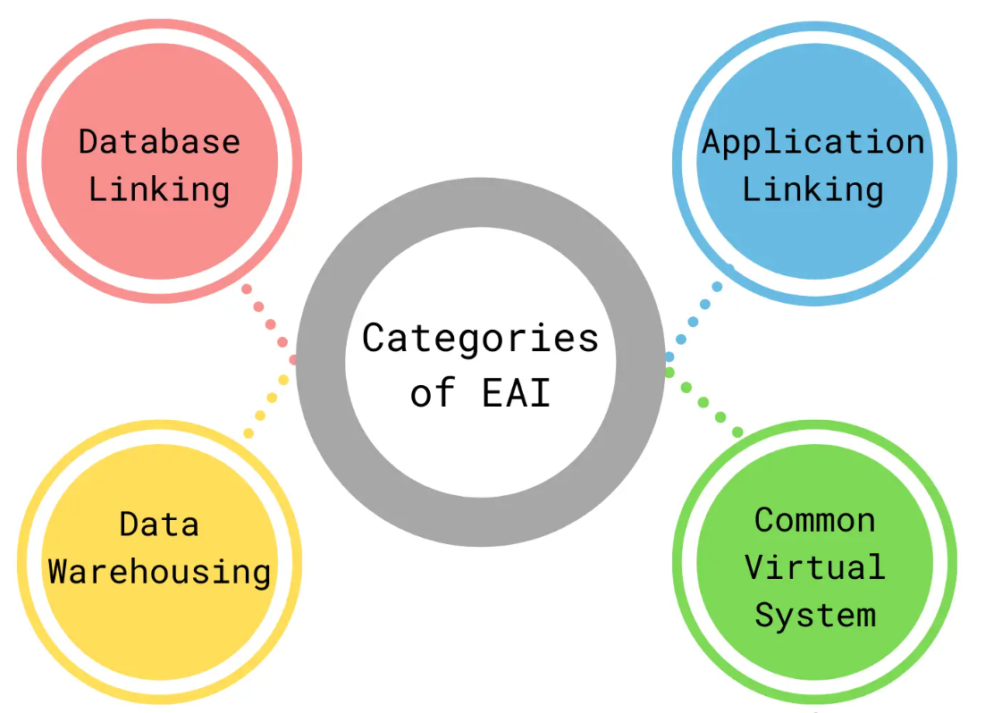
Categories

Slide 34
Categories
There are four major categories.
Database linking- databases share information and duplicate information as needed;
Application linking– the enterprise shares business processes and data between two or more applications;
Data warehousing– data is extracted from a variety of data sources and channeled into a specific database for analysis; and
Common virtual system – the pinnacle of EAI; all aspects of enterprise computing are tied together to appear as a unified application.

Slide 35
Application Integration Tools
Many application integration tools are available in the market. Some important tools are
Mulesoft
Tibco software
Informatica
Dell Bhoomi
Workato
Celigo
Cloud Elements
InterSystems
OpenLegacy
IBM
Boomi

Slide 36
The Future
The future of EAI is rapidly evolving and growing as the need for companies to connect their backend systems becomes more prevalent.
With the advent of big data, SOA, and cloud-based solutions, EAI is becoming more critical than ever before.
The EAI future looks promising:
The explosive growth of big data and the Internet of Things (IoT) drives the need for enhanced integration capabilities.
EAI platforms are becoming more agile and easier to use.
Companies increasingly look for EAI platforms to accommodate hybrid environments as they move towards cloud-based solutions.

Slide 37
Conclusion
Enterprises integrate their applications
less expensive than replacement
more efficient than “information islands“
Enterprises must establish web-presence and make business services available to web-clients
Enterprise Application Integration merges applications to create a more efficient system.
It can be used for anything from synchronizing data between systems to integrating enterprise-level software like ERP and CRM with other business applications.
The goal of EAI is not just integration but also coordination so that all parts work together seamlessly.
Notes:
information island. information island - A body of information (i.e. electronic files) that needs to be shared but has no network connection.

Slide 38
Workflow Management Systems

Slide 39
Why WfMS
A workflow management system (WfMS or WFMS) provides an infrastructure for the set-up, performance and monitoring of a defined sequence of tasks, arranged as a workflow application.
Originally for office automation
Automate administrative processes among human participants and applications
Facilitate definition and maintenance of integration logic
Processes can be interpreted and modified by business people
Notes:
Office automation refers to the varied computer machinery and software used to digitally create, collect, store, manipulate, and relay office information needed for accomplishing basic tasks.

Slide 40
WfMS Standards
There are several international standards-setting bodies in the field of workflow management:
Workflow Management Coalition
World Wide Web Consortium
Organization for the Advancement of Structured Information Standards
WS-BPEL 2.0 (integration-centric) and WS-BPEL4People (human task-centric) published by OASIS Standards Body.
Notes:
Office automation refers to the varied computer machinery and software used to digitally create, collect, store, manipulate, and relay office information needed for accomplishing basic tasks.

Slide 41
What is a WfMS
Software platform to
Design
Develope
Execute
Analyse
workflow processes
integrate different Services, Applications and human participants
Each of the workflow models has tasks (nodes) and dependencies between the nodes.
Tasks are activated when the dependency conditions are fulfilled.

Slide 42
The parts of a WfMS
Workflow definition
Workflow definition Languages
Workflow engine
Design interface
Monitoring tools and reporting capabilities
User Interface
Workflow Architecture
Notes:
A workflow consists of an orchestrated and repeatable pattern of activity, enabled by the systematic organization of resources into processes that transform materials, provide services, or process information.
A workflow engine facilitates the flow of information, tasks, and events.
In the Workflow architecture, business processes are at the middle level and they define the steps to be performed as part of the Workflow. ... Events are also used to call subsequent tasks in the workflow. All the tasks defined under the Workflow will be executed in the mentioned order as per the Workflow definition.

Slide 43
The parts of a WfMS
Monitoring
User Interface /
Application
Workflow
Instance
Resource
repository
Workflow
engine
Workflow definition

Slide 44
The Workflow definition
Formal description of a business logic
Specified by a directed graph
Defines order of execution of process nodes
Work node
Routing node
Start and completion nodes
Once designed, definitions can be “applied” to the process engine

Slide 45
The Workflow engine
Retrieve Wf definition
Determine nodes to be executed
routing node
work node
Place work into the work queue
resource accomplishes work
OR invoke method of resource API
monitor inbound queue for completion messages
determine next node to be executed
Determine
nodes out of
WF definition
Wait until
Work is
completed
Place work
Into work
queue

Slide 46
The Workflow engine (2)
Resource Broker
Outbound queues
3
4
5
resource1
Inbound queue
1
Workflow engine
resource2
resource3
2
Workflow
Definition

Slide 47
Monitoring Tools
Track and monitor individual work requests
Review resource productivity and work volume analysis
Quickly search for and identify a work request
Provide feedback on performance issues
Get information about bottlenecks in the process
Analysis to implement changes to the workflow process
Notes:
bottleneck, in a communications context, is a point in the enterprise where the flow of data is impaired or stopped entirely. Effectively, there isn't enough data handling capacity to handle the current volume of traffic.

Slide 48
User Interface
Separate work list management from workflow management
access and action work requests
individuals have a single work list
requests from different workflows

Slide 49
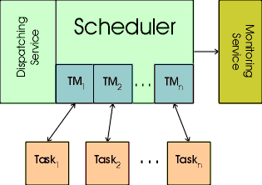
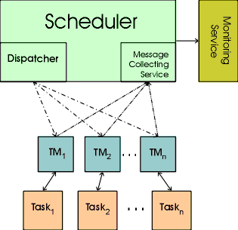
Workflow Architectures
Async. centralized Architecture
Tasmanager no longer part of Scheduler
Calling Program not blocked
No immediate action of called Program
Highly centralized Architecture
Tasmanager parts of Scheduler

Slide 50
WfMS Requirements
Scale
Dynamic resource selection and assignment
Performance management
Sophisticated Failure handling
Notes:
) developed to a high degree of complexity.
"highly sophisticated computer systems"

Slide 51
WfMS and other Middleware
Act in many ways as EAI tools
emphasis on programming in the large
Focus on workflow that manages integration
Combine WfMS and EAI into a single system

Slide 52
WfMS and other Middleware (2)
WfMS
WfMS Adapter
Message Broker
Smart quotation
adapter
database
adapter
…..
forecasting
adapter
E-mail
adapter
Smart
quotation
DBMS
Application
Smart
Forecasting

Slide 53
WfM and the Web
Services have to be described
Protocols to communicate with the Service
SOAP
Formats and protocols for invoking the Service
WSDL
Must be easy to find
Search Services by creteria
UDDI
Notes:
SOAP Simple Object Access Protocolis a messaging protocol specification for exchanging structured information in the implementation of web services in computer networks. Its purpose is to provide extensibility, neutrality, verbosity and independence.
WSDL web Services Description Language is often used in combination with SOAP and XML Schema to provide web services over the Internet. A client program connecting to a web service can read the WSDL to determine what functions are available on the server. Any special datatypes used are embedded in the WSDL file in the form of XML Schema.
UDDI is an XML-based standard for describing, publishing, and finding web services. UDDI stands for Universal Description, Discovery, and Integration. UDDI is a specification for a distributed registry of web services. UDDI is a platform-independent, open framework.

Slide 54
Web Service Integration
Outsource Services
Search for business partners
Establish partnership
Enable Service communication
Exchange of messages
Services may not be invoked in right order
New requirements: Get list of Services that fullfill them
Compose new Web Service - Publish Service
Internal details hidden from User
Notes:
Outsourcing is a business practice in which a company hires another company or an individual to perform tasks, handle operations or provide services that are either usually executed or had previously been done by the company's own employees. ... They frequently outsource customer service and call service functions.

Slide 55
Advantages of WfMS
Rapid process design and maintainance
Failure and exception handling
Catering for performance and high availability
Workflow design with graphical interface

Slide 56
Disadvantages of WfMS
Expensive software licenses
Complex installation and operation
Heavy-weight platforms

Slide 57
WfMS Tools
Activiti
Apache ODE
Apache Taverna
Apache Airflow
Appian
Bizagi
Bonita BPM
Camunda
CEITON
Collective Knowledge
Cuneiform
IBM BPM
Imixs-Workflow
QuickBase
jBPM
PRPC
ProActive
Pyrus
Qntrl
RedBooth
Salesforce.com
ServiceNow
SAP Business Workflow
TACTIC
Windows Workflow Foundation
WorkflowGen
YAWL

